Slide 1
Introduction:
What can you do with waste?
27.05.2021
ECOVIA

Slide 2
Who am I….
Jonathan Martens from Ecovia,
martens_jonathan@yahoo.com
Active in
Non-food circular services and products
Environmental impact analyses
New plastics and waste
Sustainable food consumption
Sustainable procurement training (food / non-food)
Currently
Freelance Sustainable Advisor @ Colruyt Group
Advisor for smaller private companies and associations
Guest lector (Syntra Brussels, ULB, Tada, …)
Looking for new challenges

Slide 3
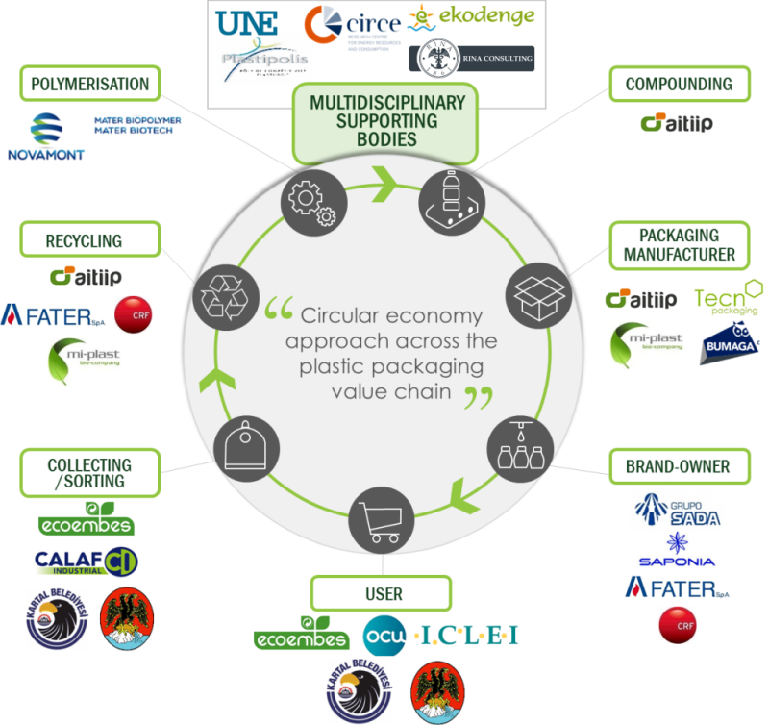
Introduction: different stages for materials?

Slide 4
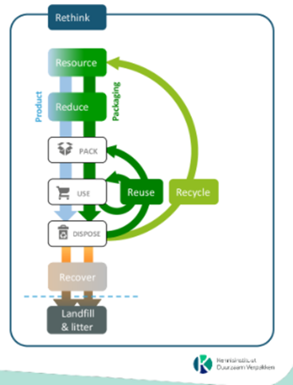
What can you work on?
Reducing the environmental impact
Get better Recyclability
Promote circularity

Slide 5
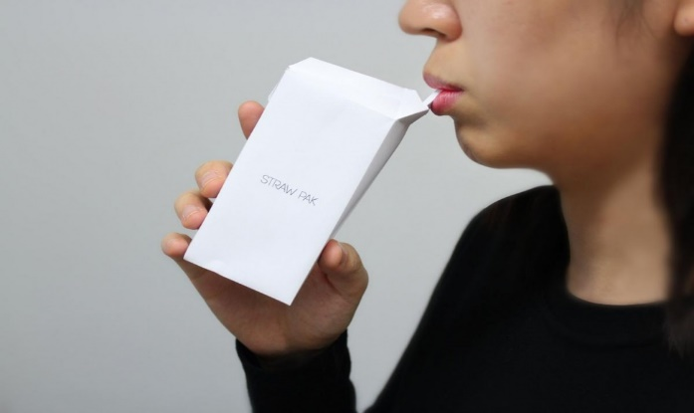
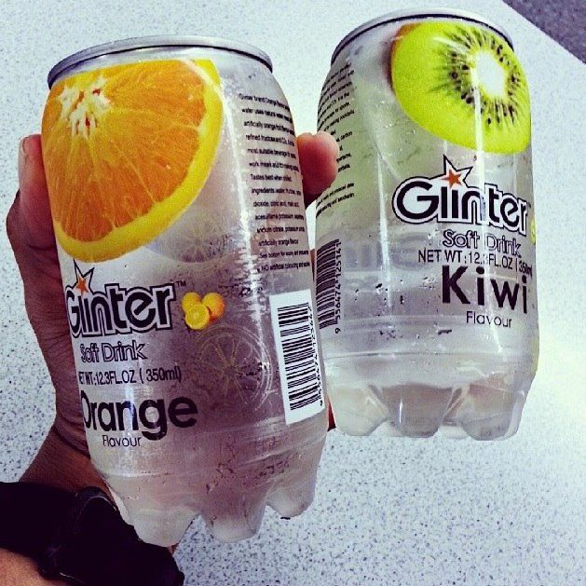
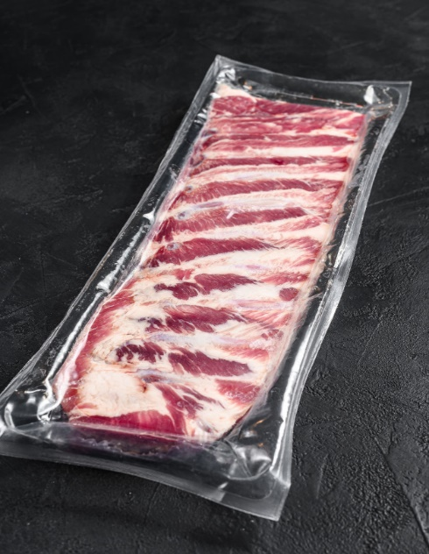
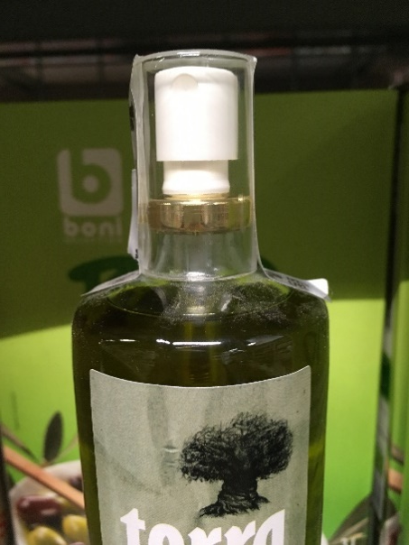
Reduce the environmental impact
Work on design
Remove
  Complexity of the material
    No paint, no composite, …
  Barrier necessary?
    What do I pack?
    No multilayer, only additives when needed
Reduce
  less material
    Do need all the features?
  Less volume
    What do you need to pack?

Slide 6
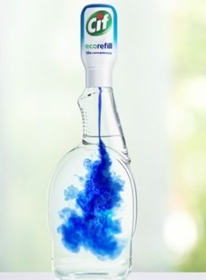
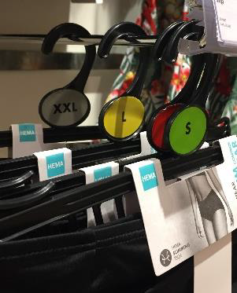
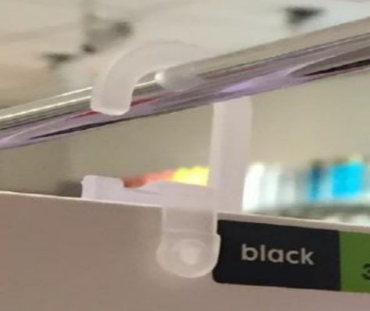
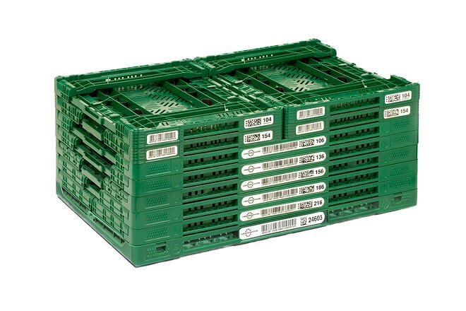
Reduce the environmental impact
Work on design - Rethink
Reuse
  can I refill? Can the supplier Refill?
  Is it more sustainable?
  Can the reuse be organized?
  Repairable
    Do you need single use?
    Does a pooling or repair service exist?

Slide 7
Recycle
Recycle is mostly combined with sorting
Depending on the quality of waste flux
Make difference between sorting and recycling

Slide 8
Current sorting obligations
Bruxelles |  | Flanders & Wallonia
les déchets dangereux | les déchets faisant l'objet d'une obligation de reprise : | ++
les papier cartons; | Graisses et huiles de fritures usagées, | organisch afval
les déchets « PMC »* : | Piles et batteries, | afvallandbouwfolies
- Bouteilles et flacons en Plastique, | Déchets d’équipements électriques et électroniques, | EPS (isomo)
- Emballages Métalliques, | Médicaments, | houtafval
- Cartons à boisson | Pneus, | metaalafval
- autres emballages plastiques(PMC+)** | Huile usagées, | recycleerbare harde kunststoffen
 | Véhicules hors usage, | textiel
les déchets de verre d'emballage blanc et de couleur; | Panneaux photovoltaïques. | matrassen
les déchets végétaux (espaces verts et jardins); | … | afgedankte voertuigen
les déchets d'animaux; |  | puin
les déchets résiduels. |  | …

Slide 9
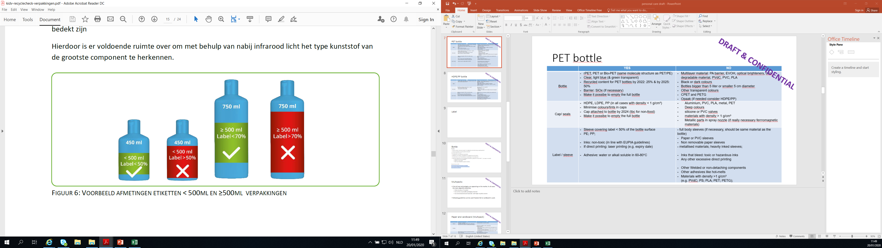
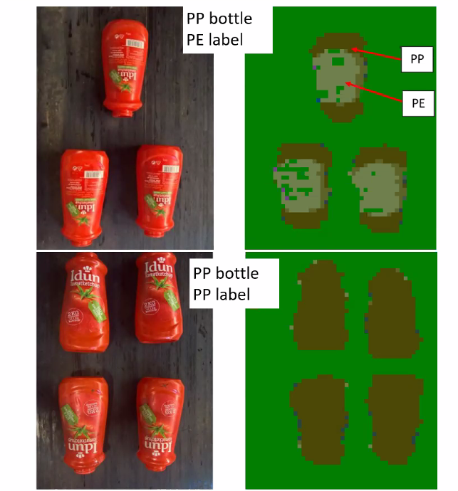
Sorting
Questions to ask
How will the sorting be organized?
    Volume
    Frequency
    Space
What influences the sorting?
    Is the material recognizable?
    Is the material big enough?
    Is there separate collection?
Go futher than legal obligations:
    Sort by type of material where possible
    Check in other regions
    If already separated during processing, don’t mix up

Slide 10
Recycle
Recycle
    Sorting does not mean necessarily recycling
    Recycle (example for plastic)
    The product must be made with a plastic that is collected for recycling, has market value and/or is supported by a legislatively mandated program.
    The product must be sorted and aggregated into defined streams for recycling processes.
    The product can be processed and reclaimed/recycled with commercial recycling processes.
    The recycled plastic becomes a raw material that is used in the production of new products.

Slide 11
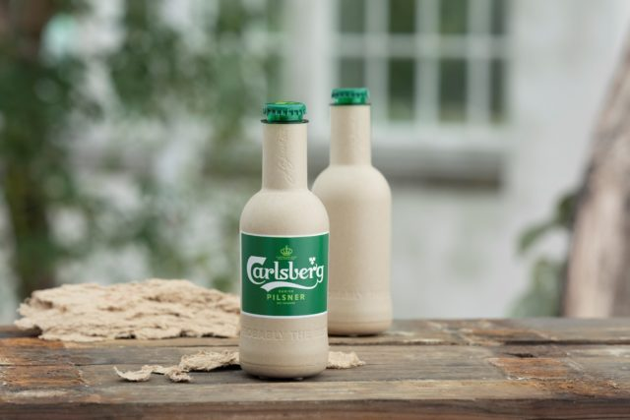
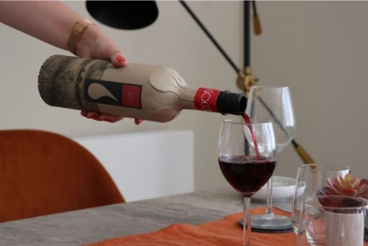
What about paper instead of plastics?
Different barriers available on the market
No global recycling test protocol available!
Paper/Cardboard is not just heat/grease/water - resistant
Ask the right questions
What is the impact of this barrier on recycling?
Quantity of fiber after recycling? How many fibers or suitable for paper/cardboard production?
Does the material gives rise to microplastics?
Denmark Bans PFAS Chemicals in Food Contact Paper and Board | SGS
Notes:
Link article foto fles

Slide 12
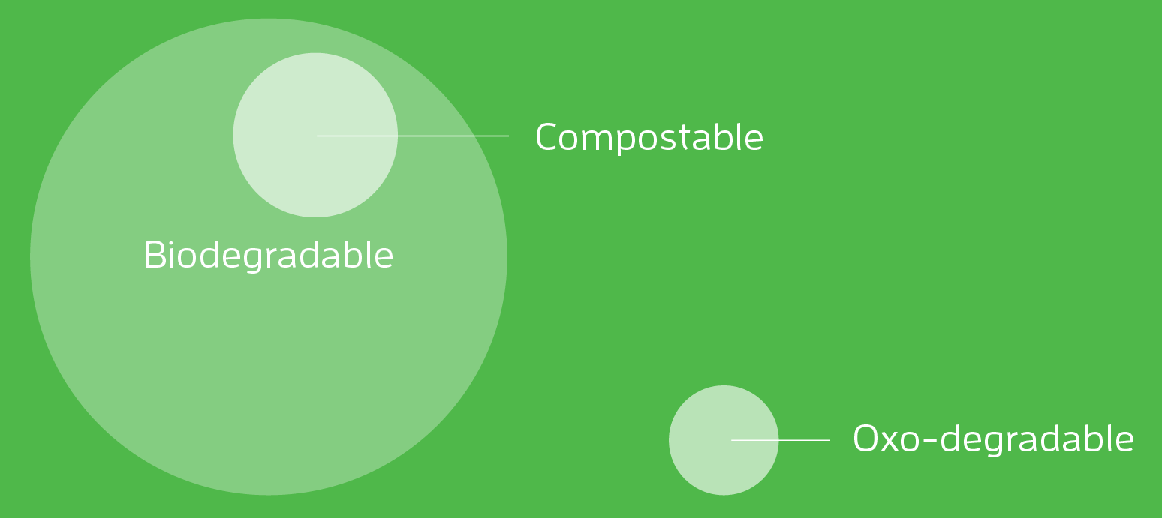
What about Bio-material? Bio-plastics? Biodegradable? Compostable?
oxo-plastics or oxo-degradable plastics !
Biodegradable
in soil, in salt water, …
Compostable
  Industrial compostable
  Home compostable

Slide 13
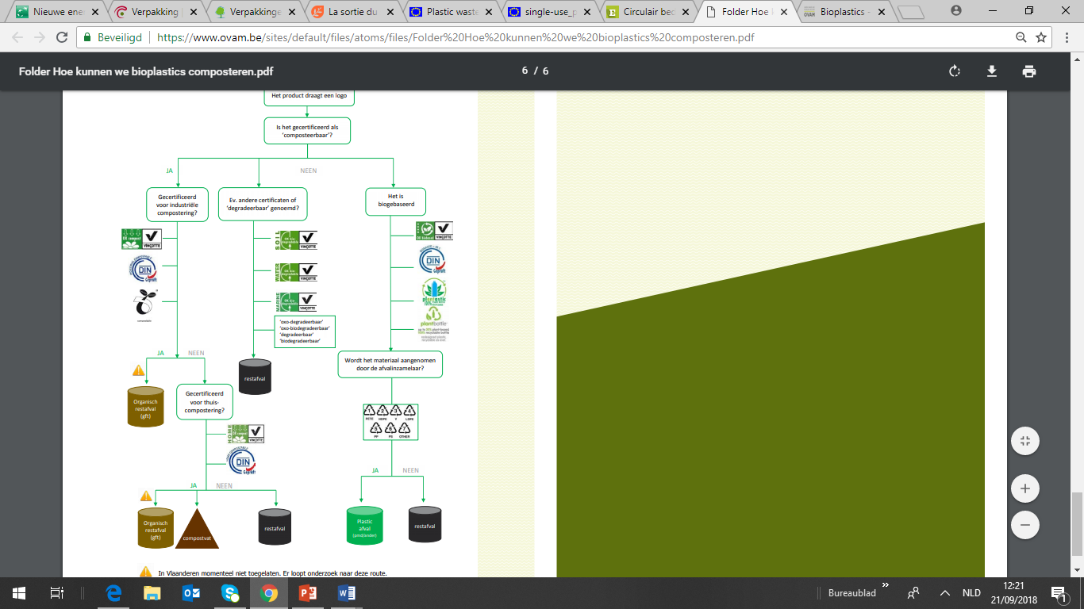
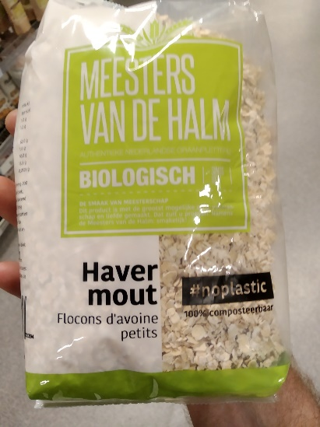
What about Bio-material? Bio-plastics? Biodegradable? Compostable?
Presented as alternative to classic plastic polymers
Bio plastic not necessarily better
Bio material not necessarily plant based
Plastic free is not always without plastics
Ask the right questions:
Notes:
Foto toevoegen

Slide 14
Recircle: introduce recycled material
Upcycling not always possible
Restriction possible concerning the use of the product/packaging
  For food packaging: Food contact compliance
  For dangerous packaging: resistance
  For construction materials: norms
  Ask the right questions?
  Post-industrial <> Post-consuming waste?
  Recycled content certificates? (is already available for some materials, but not always widely spread)

Slide 15
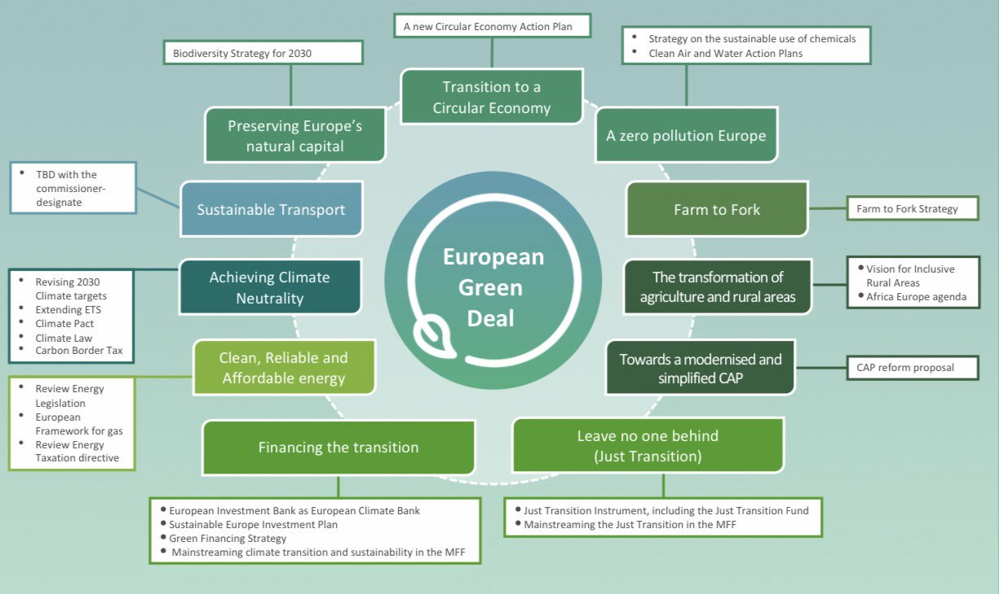
What can you expect in the future?

Slide 16
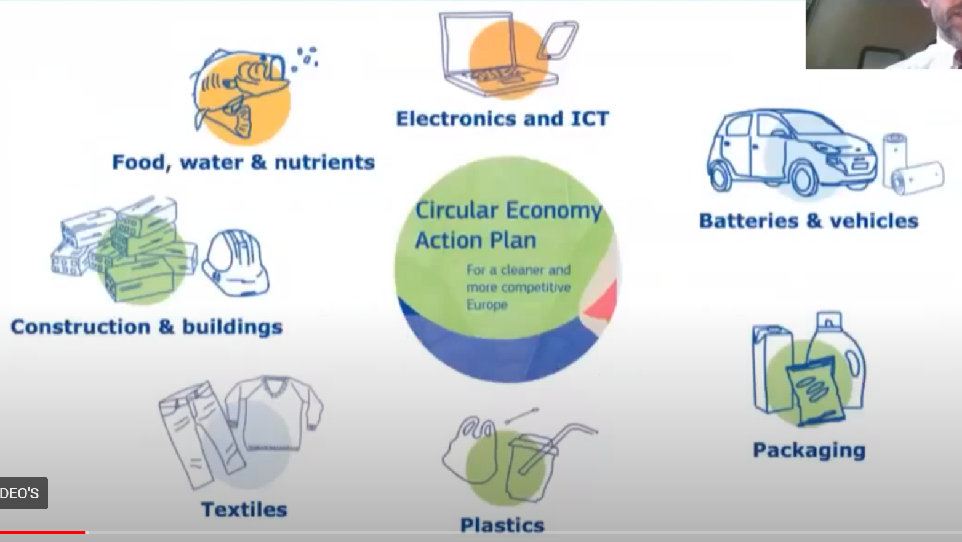
Circular economy action plan
Sustainable products will become the new norm in the EU
  Work on eco-design
  Work towards Circular Economy
  Strong focus on key products:
  Ensure less waste
  Electronics: better collection, battery life, product as a service, repairable, …
  Packaging: less volume, more recycled content, less complex, …
Notes:
Voorbeeld frankrijk (herstelbaarheid)

Slide 17
Questions?

